Slide 1


Romanian Multiword Expression Detection Using Multilingual Adversarial Training and Lateral Inhibition
Andrei-Marius Avram Verginica Barbu Mititelu Dumitru-Clementin Cercel

Slide 2

Roadmap
Motivation
Romanian PARSEME Corpus
Methodology
Evaluation Setup
Results
Conclusion

Slide 3
Motivation
The correct identification and handling of multiword expressions (MWEs) is important for various natural language processing (NLP) applications.
English
Italian
the result has come short of our expectations
il risultato ha deluso le nostre speranze
they’re struggling to find the sweet spot in the market
stanno faticando a trovare la collocazione giusta sul mercato
Andrea Zaninello et al. “Multiword Expression aware Neural Machine Translation”, Proceedings of the 12th Conference on Language Resources and Evaluation (LREC 2020).

Slide 4
Romanian PARSEME Corpus
VID (verbal idiom) - "fura somnul" , (eng., "steal sleep-the", "fall asleep'')
LVC.full (light verb construction with a semantically bleached verb) - "da citire",(eng., "give reading", "read'')
LVC.cause (light verb construction in which the verb has a causative meaning) - "da foc" (eng., "give fire", "put on fire'')
IRV (inherently reflexive verb) - "se gândi" (eng., "Refl.Cl. think", "think")

Slide 5
Romanian PARSEME Corpus
The whole corpus version 1.2 contains 5.5 million tokens with 68k VMWEs annotations:
train - 195k tokens and 1,218 annotated VMWEs
dev - 134k tokens and 818 annotated VMWEs
test - 685k tokens and 4,135 annotated VMWEs
The frequency of occurrence of VMWEs in Romanian ranges from 8\% (for LVC.full) to 22\% (for LVC.cause), with an average of 12\%, thus being quite redundant
Verginica Barbu Mititelu, The Romanian Corpus Annotated with Verbal Multiword Expressions. In Proceedings of the Joint Workshop on Multiword Expressions and WordNet (MWE-WN 2019) (pp. 13-21).

Slide 6
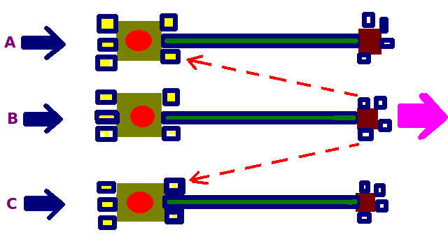
Methodology - Lateral Inhibition
In various regions of the brain, excited neurons can reduce the activity of other neighbouring neurons.
Lateral inhibition increases the contrast and sharpness in visual response.
Visual inhibition, Tactile inhibition, Auditory inhibition,....
Image by Tomwsulcer - Own work, CC0, https://commons.wikimedia.org/w/index.php?curid=15213101

Slide 7
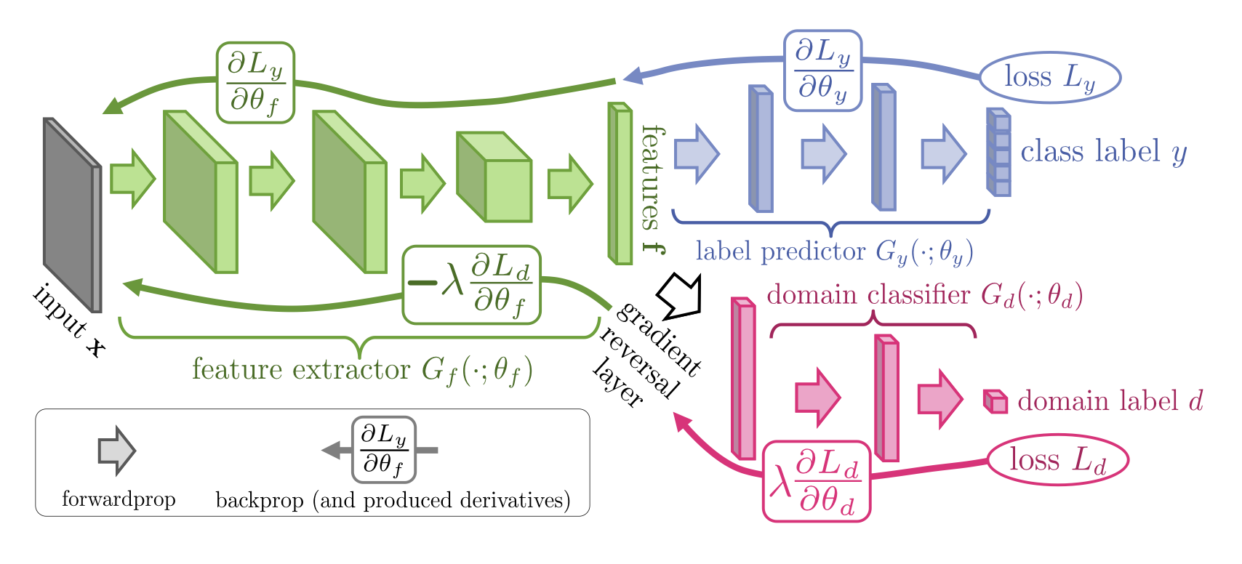
Methodology - Adversarial Training
Ganin Yaroslav et al. "Domain-adversarial training of neural networks." The journal of machine learning research, no. 1 (2016): 2096-2030.

Slide 8
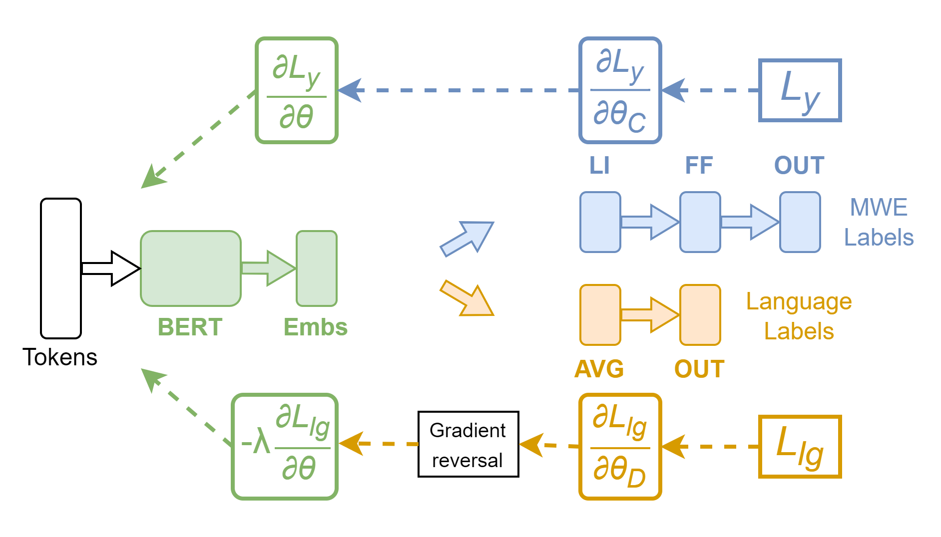
Methodology - Our System
As language independent as possible

Slide 9
Evaluation Setup
Employed two strategies:
Monolingual Training - train using only the Romanian PARSEME dataset and evaluate on the Romanian test set (no LI or adversarial training).
Multilingual Training - train using all the languages in PARSEME dataset and evaluate on the Romanian test set.
Evaluated two multilingual language models: mBERT and XLM-RoBERTa.

Slide 10
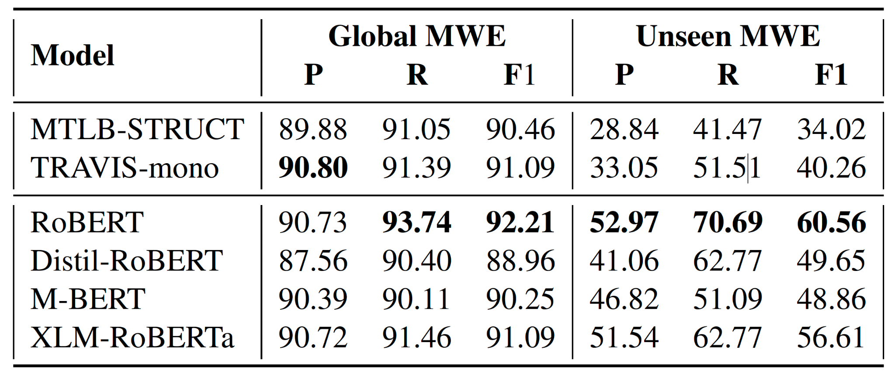
Results - Monolingual Training

Slide 11
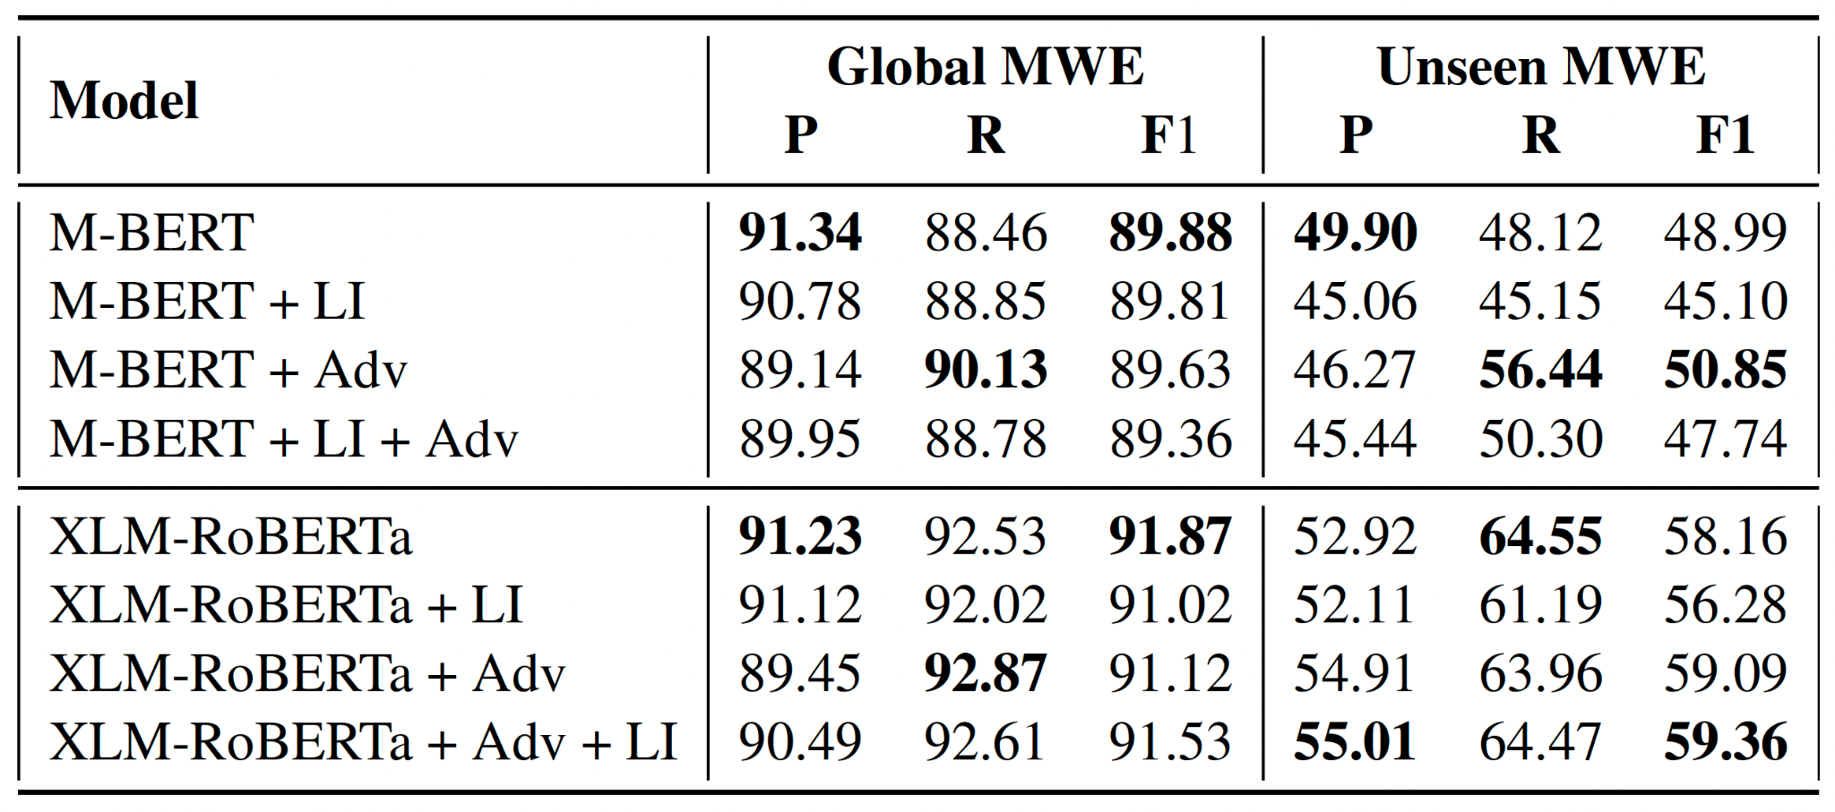
Results - Multilingual Training

Slide 12
Conclusions
Employed the lateral inhibition and the adversarial training mechanisms to boost the performance on Romanian MWE identification in a multilingual setting.
Our results showed significant improvements over the results obtained at the PARSEME competition by the MTLB-Struct and Travis-mono teams.
Future work involves studying the capabilities of these two mechanism on other languages.

Slide 13
THANK YOU
FOR YOUR ATTENTION!
Andrei-Marius Avram (avram.andreimarius@gmail.com) Verginica Barbu Mititelu Dumitru-Clementin Cercel

